Slide 1
Group 19
Oliver Chamberlain, Max Pugh, Bogdan Stefanescu

Slide 2
Emotions
Monachopsis:- The subtle but persistent feeling of being out of place.
- Using the difference in scale between the ant and what people are used to.
Chrysalism:- The amniotic tranquillity of being indoors during a rainstorm
- The player has to seek cover under blades of grass, this elicits chrysalism by creating shelter during the storm

Slide 3
Target Audience
14-22 year olds males
Log line:- Return to the safety of the anthill by seeking cover from the rain.

Slide 4
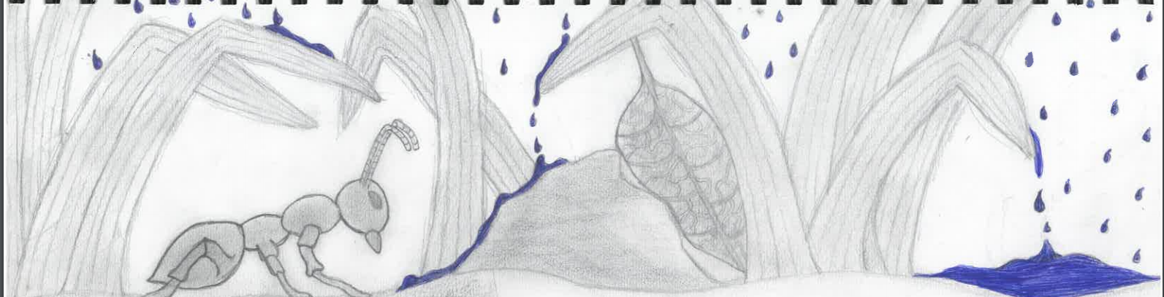
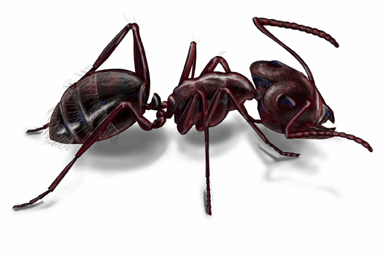
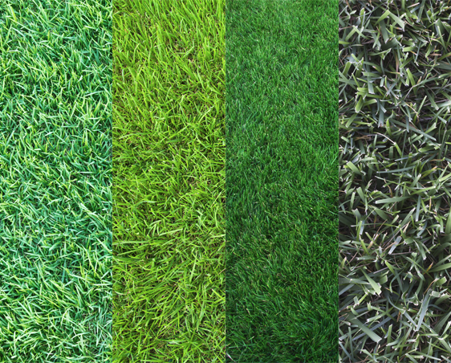
Concept art
Worker Ant
Zoysia Grass

Slide 5
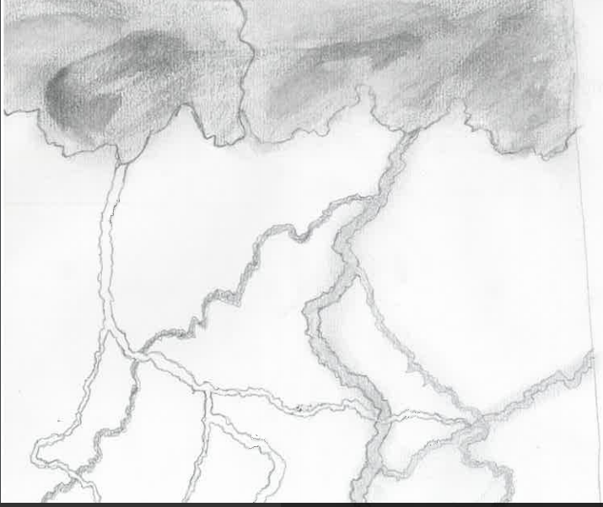
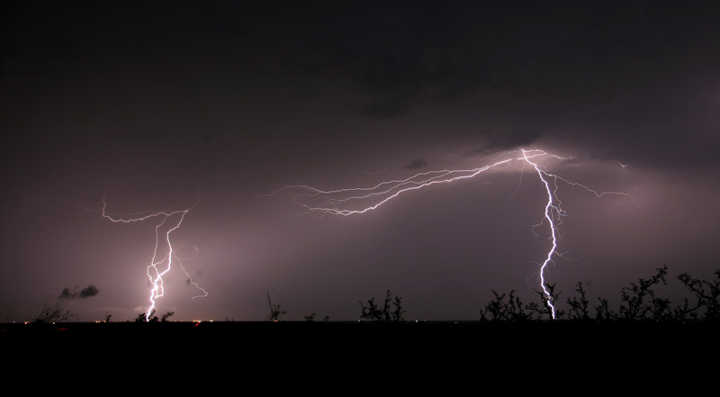


Slide 6
Mechanics
The player plays as an ant, and must avoid being caught in a rainstorm
The main mechanic is making clever use of cover as large rain drops fall from the sky
The player may pick up items along the way to use for solving the various obstacles they come across

Slide 7
Prototype

Slide 8
Questions?

